Slide 1
Analysis of Growth Functions
O(log n), O(n), O(n log n), O(n²), and O(2ⁿ)
Presented by: Lella Thannveer Reddy
Course: Design and Analysis of Algorithms

Slide 2
Purpose
Purpose of Comparing Growth Functions
Understand how algorithm execution time changes with input size.
Compare the efficiency of different algorithms.
Predict algorithm performance for large datasets.
Select the most suitable algorithm for solving real-world problems.

Slide 3
Common Growth Functions
Growth Function | Time Complexity | Example Algorithm
O(log n) | Logarithmic | Binary Search
O(n) | Linear | Linear Search
O(n log n) | Linearithmic | Merge Sort, Heap Sort
O(n²) | Quadratic | Bubble Sort, Selection Sort
O(2ⁿ) | Exponential | Recursive Fibonacci, Subset Generation

Slide 4
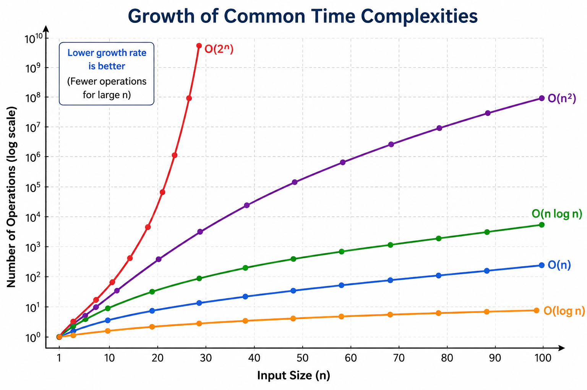
Growth Function Graph
y=2^x
O(log n): Slowest growth (best performance)
O(n): Linear growth
O(n log n): Slightly faster than linear
O(n²): Rapid growth
O(2ⁿ): Extremely rapid (exponential

Slide 5
Comparison Table
Input (n) | O(log n) | O(n) | O(n log n) | O(n²) | O(2ⁿ)
2 | 1 | 2 | 2 | 4 | 4
4 | 2 | 4 | 8 | 16 | 16
8 | 3 | 8 | 24 | 64 | 256
16 | 4 | 16 | 64 | 256 | 65,536
32 | 5 | 32 | 160 | 1,024 | 4,294,967,296
64 | 6 | 64 | 384 | 4,096 | 18,446,744,073,709,551,616

Slide 6
Practicality of Each Growth Function
O(log n):
Very efficient
Best for large datasets
Example: Binary Search
O(n):
Efficient
Suitable for most applications
Example: Linear Search
O(n log n):
Highly efficient
Best choice for sorting algorithms
Example: Merge Sort
O(n²):
Slow for large datasets
Suitable only for small inputs
O(2ⁿ):
Extremely slow
Practical only for very small inputs

Slide 7
Conclusion
Key Findings
Lower growth rates lead to faster algorithms.
O(log n) is the most efficient among these.
O(n) and O(n log n) are suitable for most real-world applications.
O(n²) becomes inefficient as input size increases.
O(2ⁿ) grows exponentially and should be avoided for large-scale problems.

